Slide 1


DATA ANALYSIS

Slide 2


Today's agenda
Project recap
Problem
The Analytics team
Process
Insights
Summary

Slide 3

Accenture has begun a 3 month POC on:​
​
An audit of Social Buzz's big data practice​
Recommendations for a successful IPO​
Analysis to find Social Buzz's top 5 most popular categories of content
Project Recap

Slide 4

PROBLEM
Over 100000 posts per day
36,500,000 pieces of content
per year!
Analysis to find Social Buzz's top 5 most popular categories of content

Slide 5
ANDREW FLEMING
Chief Technology Architect
The Analytics team
MARCUS ROMPTON
Senior Principal
Myself
Data Analyst

Slide 6
Process
1
Data Understanding
2
Data Cleaning
3
Data Modelling
4
Data Analysis
5
Uncover Insights

Slide 7

Insights
16
1897
JANUARY
UNIQUE
CATEGORIES
REACTIONS TO "ANIMAL" POSTS
MONTH WITH
MOST POSTS

Slide 8
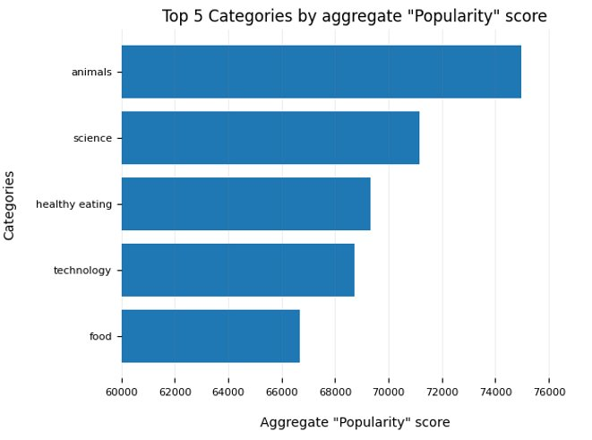

Slide 9
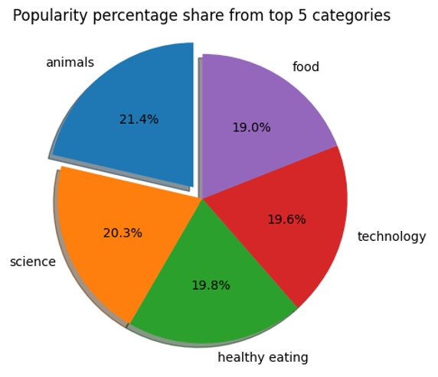

Slide 10

Animals and science are the two most popular categories of content, showing that people enjoy "real-life" and "factual" content the most.
Summary

Slide 11
Thank you!
ANY QUESTIONS?

